Slide 1
Lead Quality Prediction Model
Efficiently categorizing leads as high or low quality

Slide 2
Table of Contents
Introduction
Approach/Methods
Machine Learning Model
Model Performance
Conclusions and Future Model Improvements
The Score Feature – Qualitative Analysis
Model Deployment and Data Access

Slide 3
Introduction
ABC Bank wants to expand their outreach to B2B customers and grow their B2B business. Currently, the sales team does not engage with many of the leads qualified by marketing. The reasons for this could be for the following reasons:
Marketing is not scoring leads well (scoring is arbitrary based on various nurturing activities)
Marketing is pushing leads over too early/late (marketing qualified leads are automatically pushed over to sales when they reach a lead score of 15)
Sales is overwhelmed with the large amount of leads marketing sends over

Slide 4
Approach and Methods
The approach taken in solving the aforementioned questions is to categorize the figures in the data set as high quality or low quality.
For classification, there are many machine learning algorithms that can be implemented:
K-Means Clustering
Decision Trees
Support Vector Machine (SVM)
Random Forest
Data
The data was merged based on the prospect; their profile (company, job title, etc.) and their activities per the provided datasets.
This allows for more thorough testing to see if any included features have significance to the predictions made by the model

Slide 5
Random Forest Classifier
Why?
Performed consistently and accurately compared to other algorithms
RFC creates multiple decision trees based on randomly selected features
Allows for data analysis from different perspectives
Generates more reliable predictions.
Improving Performance
Using GridSearch, the best performing hyperparameters were calculated for improved model efficiency
Feature importance was key in determining which features were most relevant to improving accuracy

Slide 6
Overall Performance – 91%
When identifying high value leads, the model is 94% accurate, with the remaining 6% of high value leads being incorrectly classified as low value
When identifying low value leads, the model is 82% accurate, with the remaining 18% of low value leads being incorrectly classified as high value

Slide 7
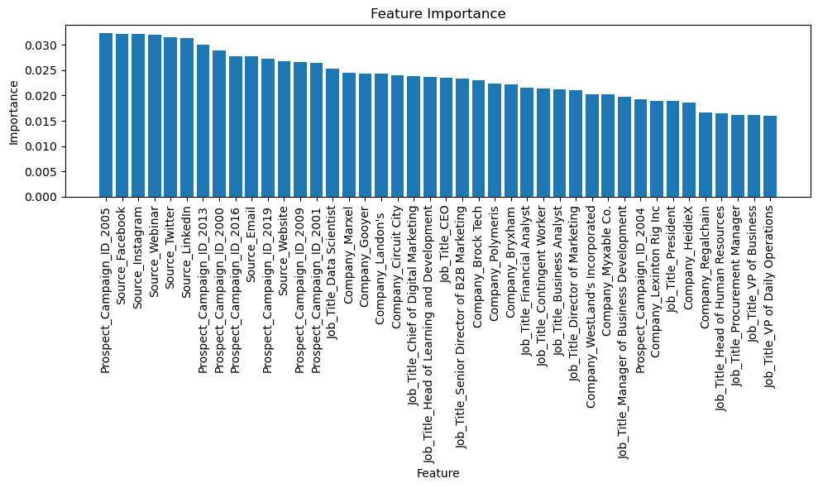
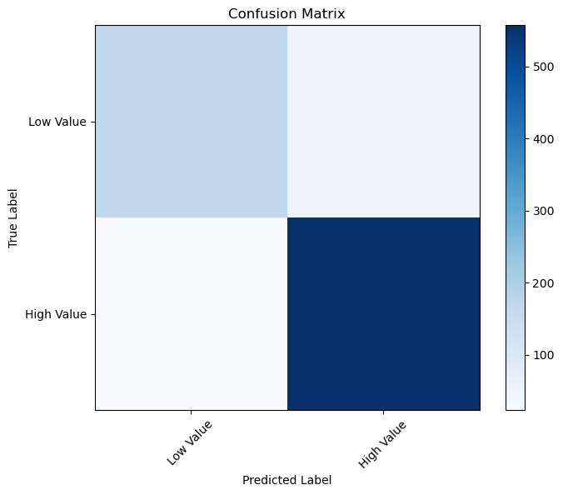
Additional Data

Slide 8
Conclusions and Improvements
The model is most accurate when identifying high value leads; this enables the sales team to pursue more high value leads.
The model is less accurate, but still adept, when identifying low value leads. This means that potentially, some high value leads would be incorrectly identified to be low value.
Improving these results
More Data: In this dataset, there are 580 high value leads provided for testing, but only 220 low value leads. More low value leads would improve performance when classifying a lead as low value.
More Features: Date/Time of prospect activity, length of activity engagement, and categories of lead generation may improve performance.

Slide 9
The Score Feature
The score feature is useful!
73% accurate!
Provides a 2% boost to the model when included for a total of 93% accuracy
This behavior calls into question how the score feature is calculated
Considered the most important feature… but only gives a 2% boost
While score is a good metric, it can and should be fine-tuned.
Pushing leads to sales at a score of 15 may not be ideal, but an in-depth analysis of the feature is needed to be certain of any improvements.

Slide 10
Model Deployment
Web Application
The model can be implemented as a web app
Authenticated users can use the app to determine if a lead with sufficient data is high or low value
This would require further feature engineering, as users may not have all necessary data for this specific model
Without sufficient data, the Score feature is about as accurate as the model at present.
Authenticated data can be added to the larger dataset for improved performance over time
Considerations
Cost
Architecture
Security

Slide 11
Questions

Slide 12
Thank you for your time!
Presentation by: Phoebe Corwin
phoebe.corwin23@gmail.com

